Slide 1

Understanding the Voice of the Customer: An Analysis of British Airways Reviews
Gaining Insights from Online Feedback
Muhammad Umer
LinkedIn

Slide 2
Introduction - Why Analyze Customer Feedback?
Customer reviews provide invaluable, direct insights into passenger experiences.
Understanding these voices helps us:
Identify key strengths and areas of excellence.
Pinpoint pain points and areas requiring improvement.
Inform strategic decisions for service enhancement.
Monitor brand perception over time.
This analysis focuses on recent British Airways reviews to gain a data-driven perspective on customer satisfaction and identify actionable insights.

Slide 3
Methodology - Our Data Science Workflow
Data Source: Customer reviews scraped from airlinequality.com.
Data Collection: Scraped 1000 reviews to build a representative dataset.
Data Cleaning & Preparation:
Handled initial data structure (index).
Extracted 'Verified' status.
Cleaned review text: removed punctuation, converted to lowercase, standardized whitespace.
Tokenized words, removed common stop words, and performed lemmatization (reducing words to root form).
Analysis & Visualization:
Examined data characteristics (review length, verification).
Analyzed overall sentiment (Positive, Neutral, Negative).
Identified most frequent words and phrases.
Analyzed mentions of specific operational/service aspects.
Model Building:
Applied Topic Modeling (Latent Dirichlet Allocation - LDA) to discover underlying themes/topics in the reviews.

Slide 4
Data Snapshot - What Reviews Did We Analyze?
Total Reviews: 1000
Review Verification Status:
74% of reviews were '✅ Trip Verified’.
26% of reviews were 'Not Verified'.
Implication: A large portion of the feedback comes from confirmed travelers, adding weight to the observations.
Review Length (after processing):
Average Length: 81 words.
Range: 10 to 327 words.
Reviews vary in detail, providing both quick feedback and in-depth accounts.

Slide 5
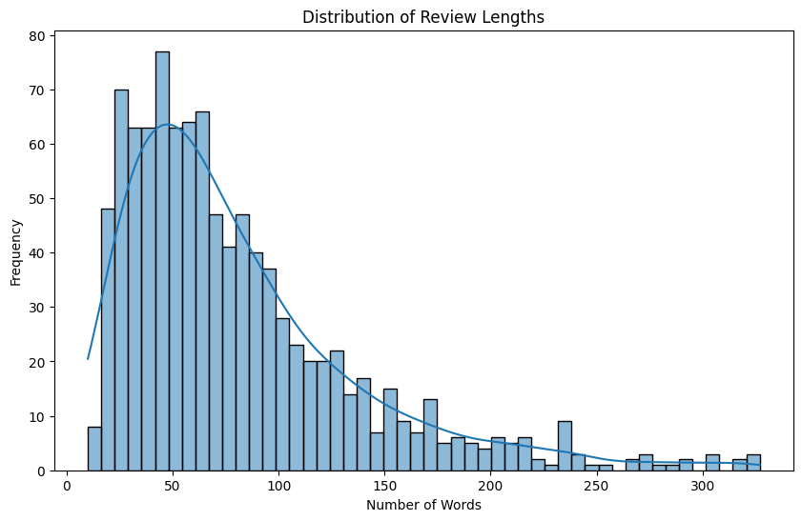

Slide 6
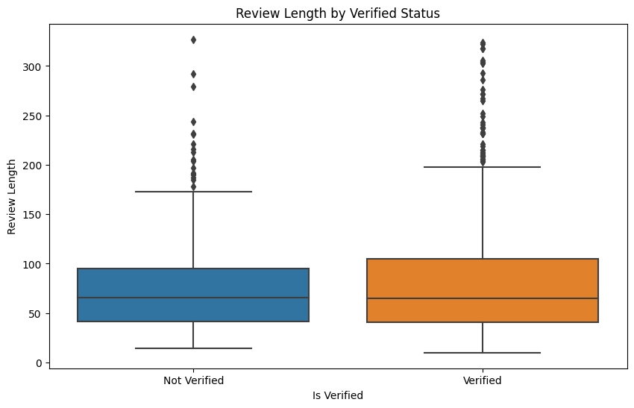

Slide 7
Overall Sentiment - The General Mood
Analyzing the processed text indicates a mixed sentiment among reviewers.
Distribution:
Neutral: 431
Positive: 395
Negative: 174
While Positive reviews slightly outnumber Negative ones, the high percentage of Neutral reviews suggests feedback often contains a mix of pros and cons, or focuses on factual accounts rather than strong emotion.
The significant number of Negative reviews (nearly 20%) indicates areas requiring attention.

Slide 8
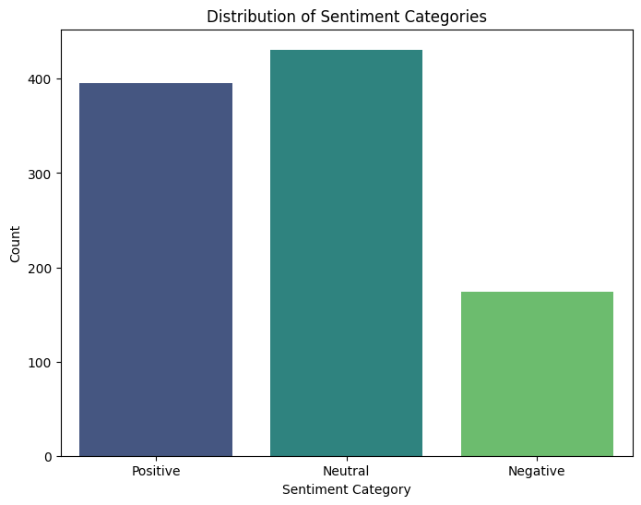

Slide 9
Sentiment by Verification Status
Comparing sentiment between Verified and Not Verified reviews:
Verified reviews tend to have a slightly higher average sentiment score 0.066.
Not Verified reviews have a slightly lower average sentiment score 0.045.
Both groups show a wide range of sentiment, indicating that both verified and unverified feedback can be strongly positive or negative.

Slide 10
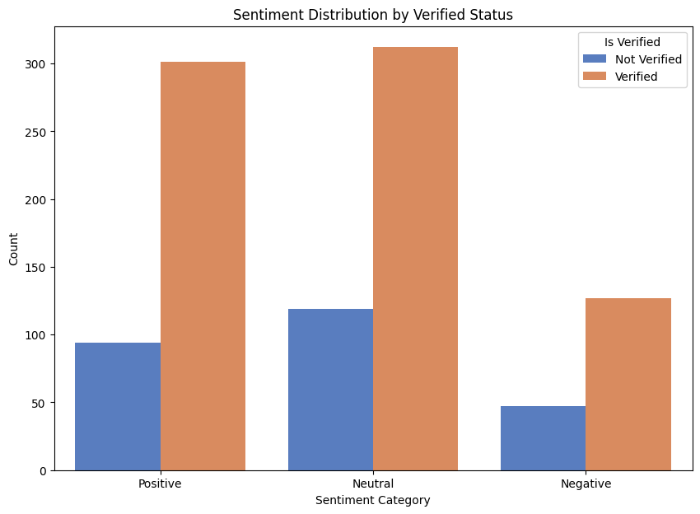

Slide 11
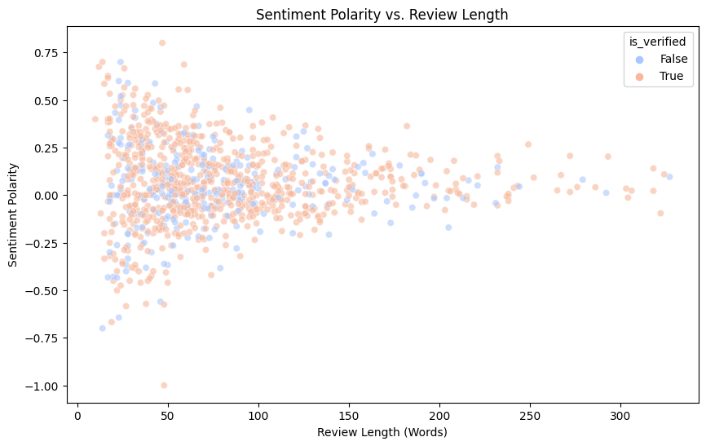

Slide 12
What Are Customers Talking About? - Common Words
Frequent words highlight the core elements customers discuss.
Top terms are heavily focused on the flight process and service components:
'flight', 'seat', 'service', 'crew', 'cabin'
'time', 'hour' (often related to delays)
'food', 'drink'
'check', 'boarding', 'gate'
Specific identifiers: 'ba', 'british', 'airway', 'london', 'heathrow'

Slide 13
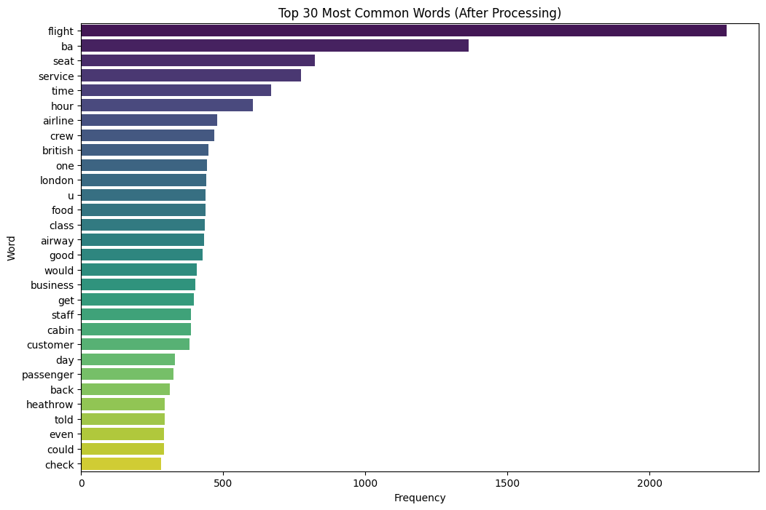

Slide 14
What Are Customers Talking About? - Key Phrases
Looking at common pairs and triplets of words provides more context.
Frequent phrases often point directly to specific experiences and issues:
'british airway' (branding)
'business class', 'premium economy', 'first class' (product tiers)
'customer service' (a major area of feedback)
'cabin crew' (human interaction)
'connecting flight', 'flight cancelled', 'flight delayed' (operational disruptions)
'baggage', 'lost luggage' (baggage issues)
'seat comfort', 'middle seat', 'leg room' (seat experience)
'food drink', 'bottle water' (catering specifics)

Slide 15
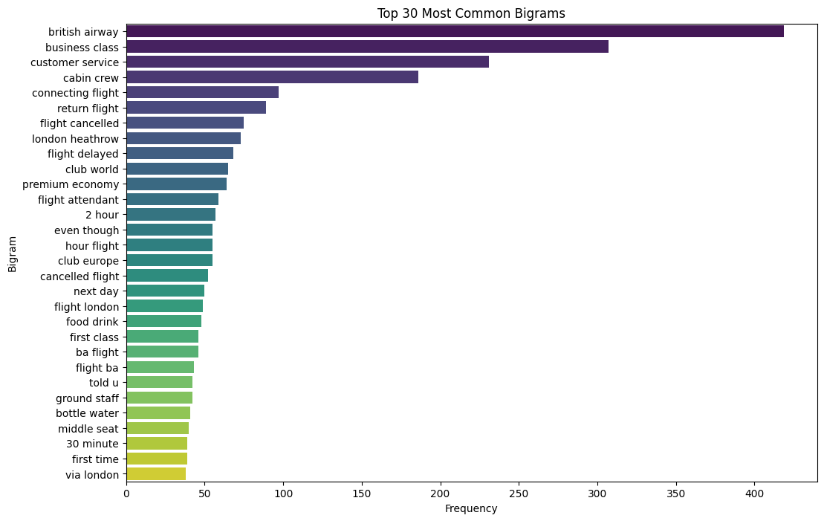

Slide 16
Focus Areas - Which Aspects Drive Feedback?
Analyzing mentions of predefined service aspects quantifies areas of focus in reviews.
Key Takeaway: These areas are where the majority of customer feedback, both positive and negative, is concentrated. Operational issues (Delays, Boarding, Baggage, Check-in) and Human Interaction (Customer Service, Staff) are particularly prominent

Slide 17
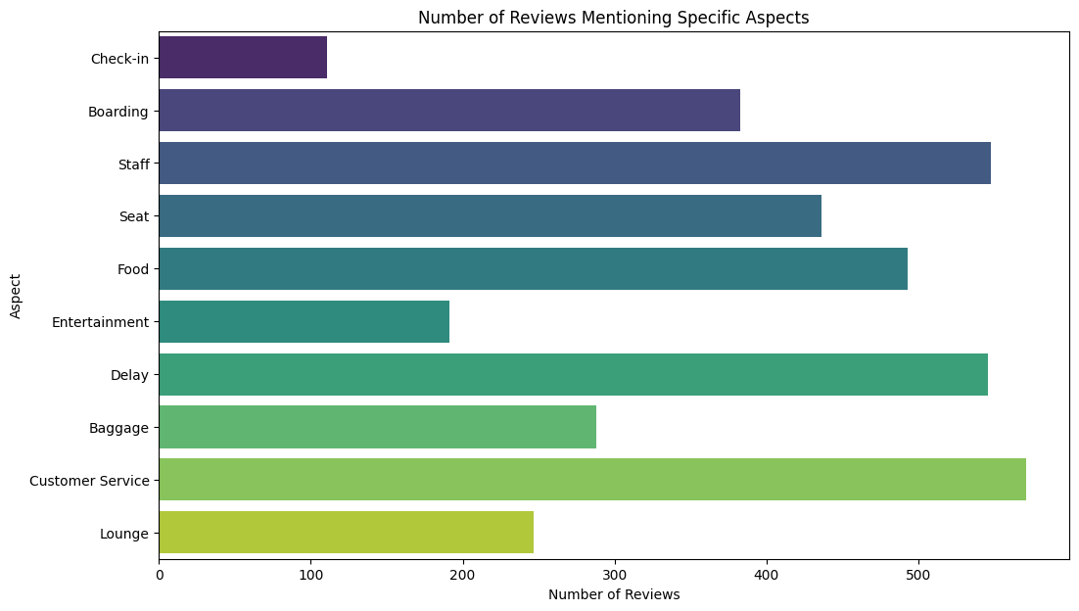

Slide 18
Deeper Dive: Uncovering Underlying Topics
Topic Modeling helps group reviews into distinct themes based on word patterns.
This allows us to understand the specific contexts in which feedback (especially negative feedback) is given.
We identified 8 core topics in the review dataset.

Slide 19
Key Findings Summary
Operational Reliability is a Major Pain Point: Delays, cancellations, missed connections, and baggage issues are recurring, significant themes driving negative feedback.
Customer Service Handling of Issues: Reviewers frequently highlight poor experiences when trying to resolve problems via phone, email, or ground staff, often involving lack of responsiveness or helpfulness.
Flight Experience Varies: While core service elements (like cabin crew friendliness or specific features) can be positive, other aspects like seat comfort (especially on older aircraft or certain classes) and food/drink quality are frequently criticized.
Communication Matters: Lack of proactive communication about delays, changes, or issue resolution exacerbates negative experiences.
Product Inconsistencies: Feedback points to variations in seat comfort, lounge quality, and service levels across different routes and aircraft types/ages.

Slide 20
Potential Next Steps
Deep Dive into Negative Topics: Conduct a more detailed qualitative analysis of reviews categorized under high-negative topics to understand specific scenarios and customer journeys.
Correlate with Operational Data: Compare the frequency of 'Delay' and 'Cancellation' mentions with actual operational performance data to identify specific routes, times, or causes that generate the most negative feedback.
Improve Communication Protocols: Review and enhance communication strategies for flight disruptions (delays, cancellations) and issue resolution processes (baggage, refunds, complaints).
Targeted Staff Training: Use insights on 'Staff' and 'Customer Service' feedback to develop targeted training programs focused on empathy, problem-solving, and clear communication in challenging situations.
Address Infrastructure Issues: Prioritize addressing frequently mentioned physical issues like seat comfort, IFE functionality, and potentially bottlenecks in check-in/baggage areas if data supports this.
Monitor Trends: Implement ongoing monitoring of customer reviews to track sentiment and topic trends over time and measure the impact of improvement initiatives.

Slide 21
Thank You
Follow me on LinkedIn: https://www.linkedin.com/in/therealumerhayat/

